Slide 1



Project Overview: Food Deserts
Project 3: Visualizing Data
We will identify locations that have very few grocery stores serving a large population (also known as Food Desert) and determine the factors that contribute toward the situation.
The GAP Team:
Shailesh, Marc, Ellis
Notes:
Shailesh

Slide 2


Project 3: Visualizing Data
Project Overview: Food Deserts
We will identify locations that have very few grocery stores serving a large population (also known as Food Desert) and determine the factors that contribute toward the situation.
The GAP Team:
Shailesh, Marc, Ellis
HEALTHY FOOD SCARCITY
POPULATION
Does a low-income population lead to a food desert?
Does the number of fast-food places correlate with population?
Why Food Deserts?
Notes:
Shailesh

Slide 3
Our Process
Project 3: Visualizing Data
Project Overview: Food Deserts
01
DATA SOURCES
04
DATABASE
Census Bureau
FRED
Georgia Dep. Of Education
Google Maps API
Prostgre SQL
Plan & Construct Schema
02
PROGRAMMING
05
VISUALIZATIONS
We will identify locations that have very few grocery stores serving a large population (also known as Food Desert) and determine the factors that contribute toward the situation.
Python
Plotly
Dash
JavaScript
Bar-Line Combo Chart
Stacked Bar Chart
Scatter Plot
Heat Map
HEALTHY FOOD SCARCITY
Why Food Deserts?
POPULATION
Does a low-income population lead to a food desert?
Does the number of fast-food places correlate with population?
03
DATA MUNGING
06
WEB DEVELOPMENT
Combine
Sort
Clean (Remove Duplicates and Drop Columns)
<Briefly elaborate on what
you want to discuss.>
Notes:
Shailesh

Slide 4
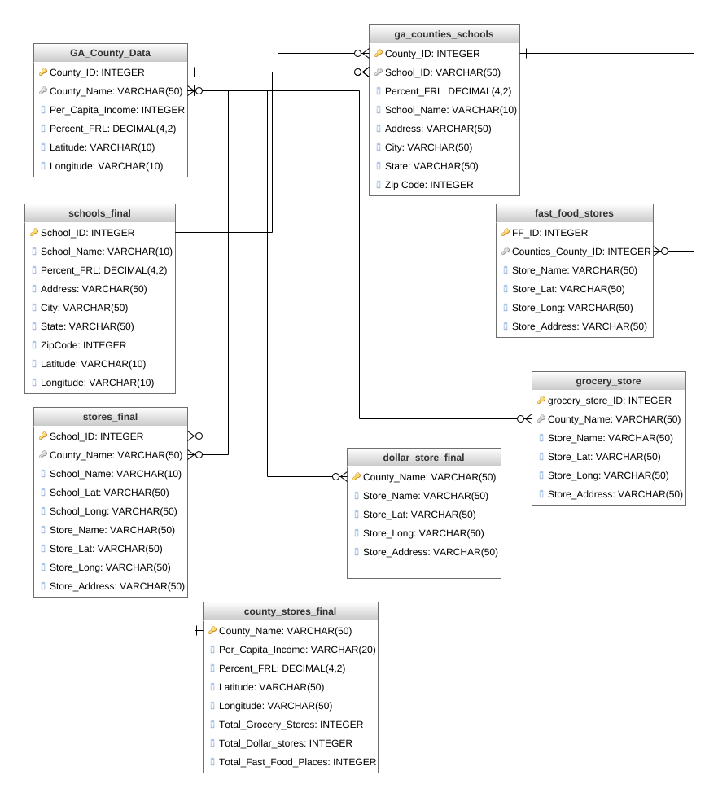
Project 3: Visualizing Data
Our Database Relationship Diagram
Our Process
01
DATA SOURCES
04
DATABASE
Census Bureau
FRED
Georgia Dep. Of Education
Google Maps API
Prostgre SQL
Plan & Construct Schema
Access the full diagram here:
app.genmymodel.com
02
PROGRAMMING
05
VISUALIZATIONS
Python
Plotly
Dash
JavaScript
Bar-Line Combo Chart
Stacked Bar Chart
Scatter Plot
Heat Map
HEALTHY FOOD SCARCITY
POPULATION
Does a low-income population lead to a food desert?
Does the number of fast-food places correlate with population?
03
DATA MUNGING
06
WEB DEVELOPMENT
Combine
Sort
Clean (Remove Duplicates and Drop Columns)
<Briefly elaborate on what
you want to discuss.>
Why Food Deserts?
Notes:
Shailesh

Slide 5
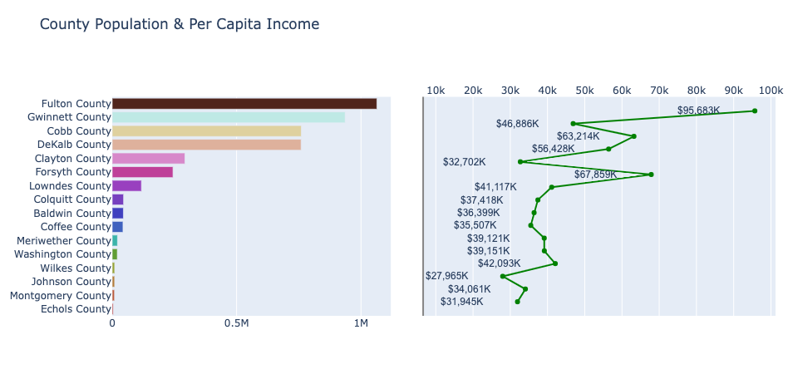
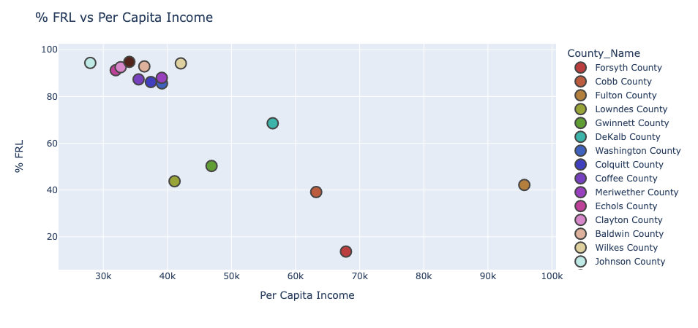
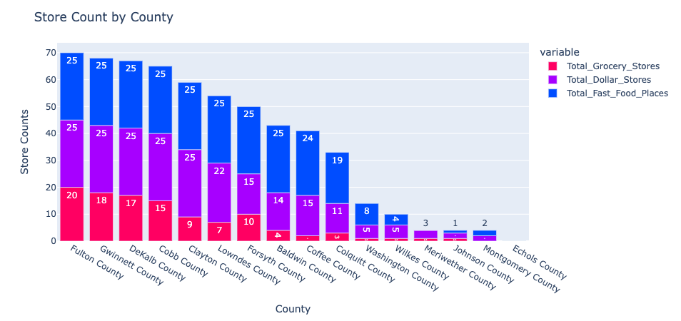
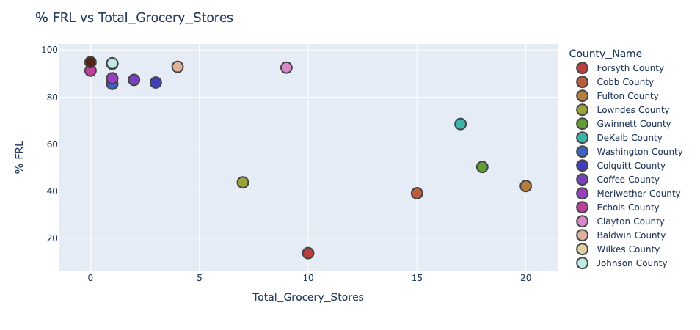
Our Process
Project 3: Data Visualizations
Project 3: Visualizing Data
4 Charts
Our Database Relationship Diagram
01
DATA SOURCES
04
DATABASE
Census Bureau
FRED
Georgia Dep. Of Education
Google Maps API
Prostgre SQL
Plan & Construct Schema
02
PROGRAMMING
Access the full diagram here:
app.genmymodel.com
05
VISUALIZATIONS
Python
Plotly
Dash
JavaScript
Bar-Line Combo Chart
Stacked Bar Chart
Scatter Plot
Heat Map
03
DATA MUNGING
06
WEB DEVELOPMENT
Combine
Sort
Clean (Remove Duplicates and Drop Columns)
<Briefly elaborate on what
you want to discuss.>
Notes:
Marc

Slide 6
Project 3: Visualizing Data
Project 3: Data Visualizations
Our Database Relationship Diagram
Chart #1
4 Charts
Access the full diagram here:
app.genmymodel.com
These 2 graphs show the correlation between County Population and Per Capita Income. Counties with a high population tend to have a higher Per Capita Income than those with a lower population.
Notes:
Ellis

Slide 7
Project 3: Data Visualizations
4 Charts
Chart #1
Chart #2
These 2 graphs show the correlation between County Population and Per Capita Income. Counties with a high population tend to have a higher Per Capita Income than those with a lower population.
The graph shows that there is a weak negative correlation between a county's % FRL and it's Per Capita Income. There is a cluster of counties located where the % FRL is high and the Per Capita Income level is low. The high % FRL may be due to the low Per Capita Income level of that county. As the Per Capita Income level of a county increases, the % FRL decreases. The low % FRL may be due to the high Per Capita Income level of that county.
Notes:
Ellis
Correlation - Population and Income
High Population -> High Income

Slide 8
Project 3: Data Visualizations
Chart #1
Chart #3
Chart #2
The graph shows that there is a weak negative correlation between a county's % FRL and it's Per Capita Income. There is a cluster of counties located where the % FRL is high and the Per Capita Income level is low. The high % FRL may be due to the low Per Capita Income level of that county. As the Per Capita Income level of a county increases, the % FRL decreases. The low % FRL may be due to the high Per Capita Income level of that county.
Like Chart #2, this graph shows a weak negative correlation between a county's % FRL and it's Total Grocery Stores. There is a cluster of counties located where the % FRL is high and the Grocery Store count is low. The high % FRL may be due to the low Per Capita Income level of that county. As the Grocery Stores count of a county increases, the % FRL tend to decrease.
These 2 graphs show the correlation between County Population and Per Capita Income. Counties with a high population tend to have a higher Per Capita Income than those with a lower population.
Notes:
Ellis
Weak Negative Correlation
Cluster Counties - High FRL, Low Income
Income ^ FRL v

Slide 9
Project 3: Data Visualizations
Chart #3
Chart #2
Chart #4
Like Chart #2, this graph shows a weak negative correlation between a county's % FRL and it's Total Grocery Stores. There is a cluster of counties located where the % FRL is high and the Grocery Store count is low. The high % FRL may be due to the low Per Capita Income level of that county. As the Grocery Stores count of a county increases, the % FRL tend to decrease.
The graph shows that there is a moderate pattern of equal distribution of Fast Food, Dollar and Grocery Stores. There are many confounding variables that may influence this behavior pattern, but one variable may be due to the population of each county. A higher population and/or income may lead to more stores than a lower population and/or income.
The graph shows that there is a weak negative correlation between a county's % FRL and it's Per Capita Income. There is a cluster of counties located where the % FRL is high and the Per Capita Income level is low. The high % FRL may be due to the low Per Capita Income level of that county. As the Per Capita Income level of a county increases, the % FRL decreases. The low % FRL may be due to the high Per Capita Income level of that county.
Notes:
Ellis
Weak Negative Correlation
Cluster Counties - High FRL, Low Grocery Count
Grocery ^, FRL v

Slide 10
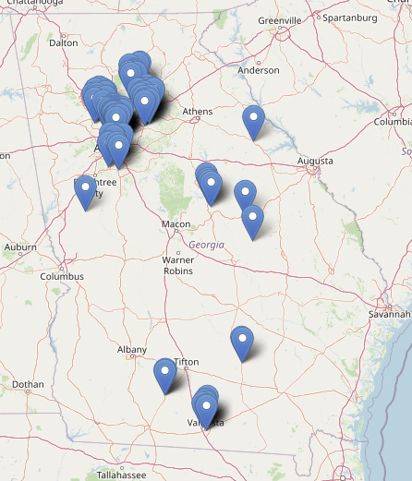
Project 3: Data Visualizations
Chart #3
Chart #4
Interactive Heat Map
Demonstrated by Shailesh
The graph shows that there is a moderate pattern of equal distribution of Fast Food, Dollar and Grocery Stores. There are many confounding variables that may influence this behavior pattern, but one variable may be due to the population of each county. A higher population and/or income may lead to more stores than a lower population and/or income.
Like Chart #2, this graph shows a weak negative correlation between a county's % FRL and it's Total Grocery Stores. There is a cluster of counties located where the % FRL is high and the Grocery Store count is low. The high % FRL may be due to the low Per Capita Income level of that county. As the Grocery Stores count of a county increases, the % FRL tend to decrease.
Notes:
Ellis
Moderate equal dist.
High Pop and Income = More Stores

Slide 11

Project 3: Data Visualizations
Chart #4
Interactive Heat Map
Demonstrated by Shailesh
Conclusion
Areas with higher levels of poverty are more likely to become Food Deserts. Additionally, poorer countries not only have fewer Grocery stores, but they also have larger numbers of Dollar stores and Fast-Food places proportionate to their population.
The graph shows that there is a moderate pattern of equal distribution of Fast Food, Dollar and Grocery Stores. There are many confounding variables that may influence this behavior pattern, but one variable may be due to the population of each county. A higher population and/or income may lead to more stores than a lower population and/or income.
Notes:
Shailesh

Slide 12
Conclusion
Areas with higher levels of poverty are more likely to become Food Deserts. Additionally, poorer countries not only have fewer Grocery stores, but they also have larger numbers of Dollar stores and Fast-Food places proportionate to their population.
Interactive Heat Map
Demonstrated by Shailesh
Notes:
Shailesh

